Slide 1
Making this resource work for you
Prior to teaching this lesson, please refer to the ‘Unit Overview and Planning Document’.
Further guidance on planning Science Mastery lessons can be found in the detailed planning guidance document.
Refer to the ‘notes’ section on each slide for useful information, including suggested expositions, pedagogical content knowledge, suggested questions, answers and more. Consider using presenter mode so you can see this guidance throughout the lesson.
The introduction slides can be adapted to suit your teaching style and the needs of your class.
Before the lesson, adapt the fix-it slide to address any misconceptions identified in the previous lesson’s exit ticket.
Choose from the suggested activities to suit your class. The intention is not that you complete all of these, but that you select those which ones are most appropriate for your students. It may be appropriate to further adapt activities for your students.
These lessons are designed to occupy approximately 1 hour. To adapt for a shorter or longer lesson duration we advise you to adapt the activity section accordingly.
Please consider using the final slide to send feedback about this lesson or examples of PowerPoints that you have adapted to our design team. Your feedback is used to improve Science Mastery for all of our teachers and students. We appreciate all suggestions and comments.
Thank you for reading!
The Science Mastery Team

Slide 2
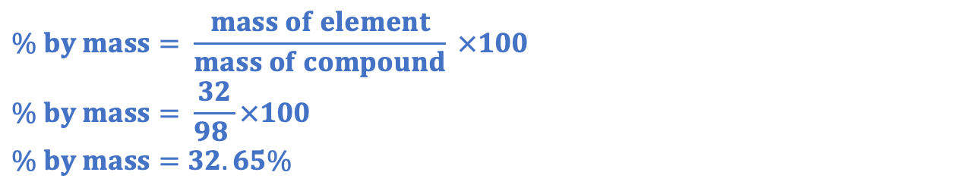
Feedback Lesson
Answer the questions below.
State the chemical formula for sulfuric acid.
Calculate the relative formula mass of sulfuric acid.
Calculate the percentage by mass of sulfur in sulfuric acid.
State the ion that acids produce in aqueous solutions.
State the pH range of acids.
H₂SO₄
(1x2)+32+(16x4) = 98
$$\% by mass= \frac{mass of element}{mass of compound} ×100$$
$$\% by mass= \frac{32}{98 }×100$$
$$\% by mass=32.65\%$$
Hydrogen ion (H+)
Less than 7 (1-6)
Notes:
Big idea: Reactions rearrange matter
Foundation: State the ion that alkalis produce in aqueous solutions.
Stretch: Explain the difference between a base and an alkali.
Answers:
Foundation: Hydroxide (OH⁻)
Stretch: A base is a substance that can neutralise an acid. An alkali is a soluble base.

Slide 3
Feedback Lesson
Do Now:
State the chemical formula for sulfuric acid.
Calculate the relative formula mass of sulfuric acid.
Calculate the percentage by mass of sulfur in sulfuric acid.
State the ion that acids produce in aqueous solutions.
State the pH range of acids.
Drill:
Calculate the M_{r} of sodium hydroxide.
Calculate the M_{r} of calcium carbonate.
Calculate the M_{r} of lithium sulfate.
Notes:
Drill answers:
40
100
130

Slide 4
Feedback Lesson
Read Now:
Quantitative chemistry (which can sometimes also be called stoichiometry) is the use of balanced chemical equations to determine quantitative (numerical) values of reactants and products in chemical reactions. As atoms cannot be created or destroyed in a chemical reaction, chemical equations must always be balanced using coefficients. These coefficients help us work out the ratios in which reactants react and products are made.
Describe where the reactants and products are found in a chemical equation.
Explain why chemical equations have to be balanced.
State the name given to the ‘big’ numbers used to balance chemical equations.
Give the other name for quantitative chemistry.

Slide 5
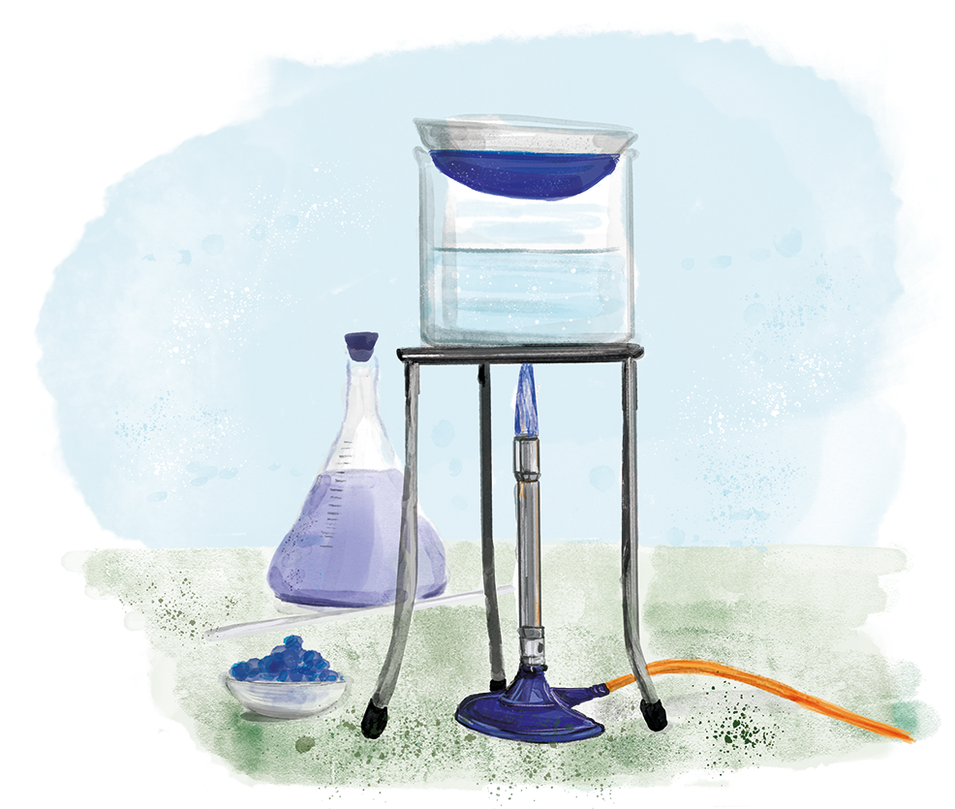
C4.3.16
15/11/2023
Feedback Lesson
C4.3.1 Prior Knowledge Review
C4.3.2 Introducing the Mole
C4.3.3 Mole Calculations
C4.3.4 PKR: Concentration
C4.3.5 TIF: Calculating Concentration
C4.3.6 TIF: Calculating an Unknown Concentration
C4.3.7 (HT) Amounts of Substances in Equations
C4.3.8 (HT) Limiting Reactants
C4.3.9 PKR: Reactions of Acids
C4.3.10 Acids, Alkalis and Neutralisation
C4.3.11 TIF: Acid-Alkali Titration
C4.3.12 TIF: Acid-Alkali Titration Analysis
C4.3.13 TIF: Titration Calculations
C4.3.14 (HT) Strong and Weak Acids
C4.3.15 TIF: Volumes of Gases
C4.3.16 Feedback Lesson
Notes:
Big idea: Reactions rearrange matter

Slide 6

Following this lesson, students will be able to:
[Teacher to edit objectives based on mastery quiz outcomes]
[Teacher to edit objectives based on mastery quiz outcomes]
[Teacher to edit objectives based on mastery quiz outcomes]
Key Words:

Slide 7
This is the fix-it portion of the lesson
The fix-it is an opportunity to respond to gaps in knowledge, especially those identified by the pre-unit quiz.
The teacher should customise this slide as needed, to facilitate
reteach, explanation, demonstration or modelling of ideas and concepts that students have not yet grasped or have misunderstood.
practise answering specific questions or of key skills.
redrafting or improving previous work.
Notes:
Purpose: to spend time on any gaps identified in previous learning from mastery quiz.
Fix-it guidance can be found on the mark scheme for the mastery quiz.

Slide 8
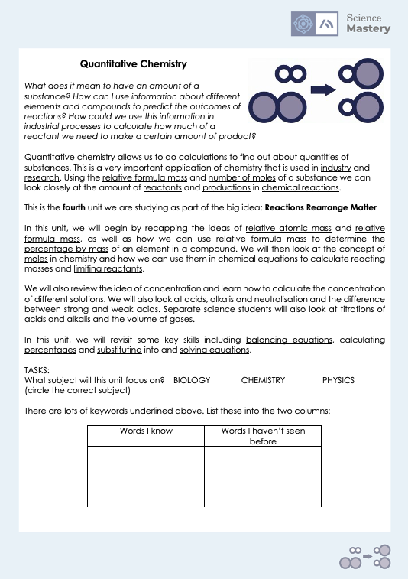
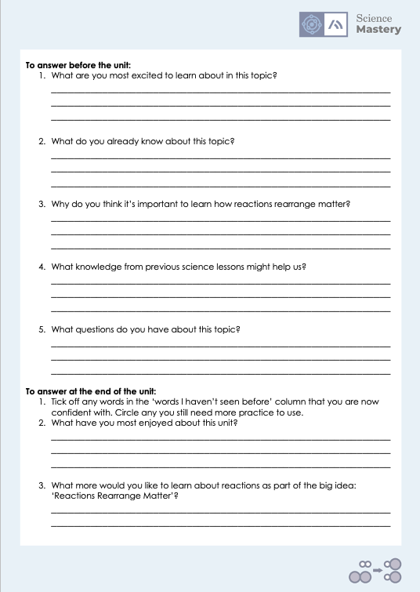
The Big Idea: Reactions rearrange matter
Notes:
Purpose:. The purpose of this resource is to provide students with an overview at the beginning and end of each unit. It is designed to create a discussion about the unit prior to the sequence of lessons.
Teacher guidance:
Pupils should be directed to the C4.3 Link to Big Ideas worksheet (either in their booklet or printed).
Teachers should use guided reading techniques to read aloud with the pupils. Tier 3 vocabulary has been highlighted. (It may need to be adapted further for LPAs or pupils with different reading ages.)
Questions on the student sheet:
1. What are you most excited to learn about in this topic?
2. What do you already know about this topic?
3. What is matter?
4. Why do you think it’s important to learn that ecosystems recycle resources?
5. What knowledge from previous science lessons might help us?
6. What questions do you have about this topic?
There are a range of ways to use this resource:
1. Display on a slide for students to read as a class. Direct students to complete the activities in their book.
2. Print off for students to stick into their book at the beginning of the unit along with their knowledge organiser. Complete as a guided reading task together. Direct students to complete the activities.
3. Have students complete as part of a booklet.
Set as a homework prior to a unit.
If you have any feedback about how this resource could be used/improved, please contact the science mastery team: sciencemastery@arkonline.org

Slide 9
Answers – Section A: Combined Science
Question | Answer
1
2
3
4
5
6
7
8
9
10
11
12
13
14
15 (HT)
16 (HT)
17 (HT)
18 (HT)
19 (HT)
20 (HT)
21 (HT)
B
C
A
B
A
B
B
C
A
A
B
C
C
B
A
B
C
C
B
C
B
Notes:
Note – these answers are different for the CS and the SS quizzes
Purpose: for students to correct their answers so they can see where they made errors and have a corrected quiz stuck in their books
Suggested guidance: talk through each question and cold call students to explore why the incorrect options are wrong. Students should write annotations on their marked quiz so they can revise from it.

Slide 10
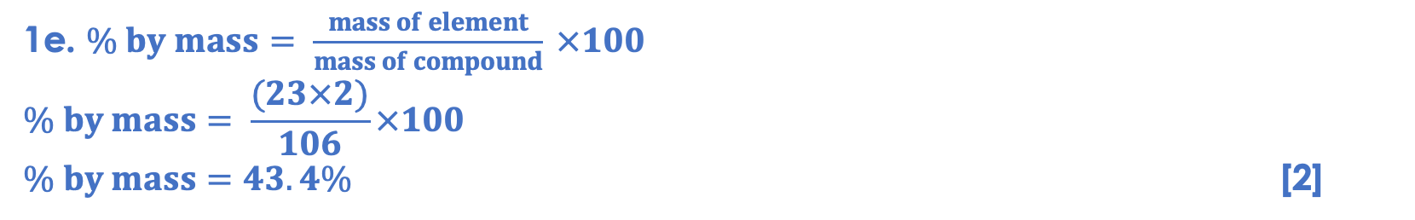
Answers – Section B
1a. The law of conservation of mass states that the mass of the products is equal to the mass of the reactants. [1]
1b.
The total mass of the reactants (Beaker A and contents before mixing + beaker B and contents before mixing) is not equal to the measured mass of beaker A and B and contents after mixing. [1]
This is because a gas (CO₂) is produced, which dissipates into the atmosphere and so it’s mass is not measured on the balance. [1]
1c. 0.01 g [1]
1d. (23x2)+12+(16x3) = 106 [1]
1e. $\% by mass= \frac{mass of element}{mass of compound} ×100$
$$\% by mass= \frac{(23×2)}{106}×100$$
$\% by mass=43.4\%$ [2]
1f. CO₃²⁻ [1]
1g. H⁺ ions [1]
1h. Red [1]
Notes:
Purpose: for students to correct their answers so they can see where they made errors and have a corrected quiz stuck in their books
Suggested guidance: talk through each question and cold call students to explore why the incorrect options are wrong. Students should write annotations on their marked quiz so they can revise from it.

Slide 11
Answers – Section B
2a.
1 mole of sodium chloride = 23 + 35.5 = 58.5 g
11.5 grams of sodium chloride = 11.5/58.5 = 0.1965 moles
1 mole of sodium carbonate makes 2 moles of sodium chloride (from the equation)
So, 0.098 moles of sodium carbonate make 0.17965 moles of sodium chloride
To find the mass of sodium carbonate that is equal to 0.098 moles:
0.098 moles = mass/relative formula mass
0.098 x relative formula mass = mass
0.098 x (106) = 10.42 g [5]
2b.
The solution with a concentration of 1.0 x 10⁻³ mol/dm³ is more concentrated than the solution with a concentration of 1.0 x 10⁻⁵ mol/dm³ by a factor of 100 (10 x 10). Therefore the pH of the second solution will be greater by 2. So, the second solution has a pH of 4. [2]

Slide 12
Answers – Section A: Separate Science
Question | Answer
1
2
3
4
5
6
7
8
9
10
11 (HT)
12 (HT)
13 (HT)
14 (HT)
15 (HT)
16a (HT)
16b (HT)
17 (HT)
A
C
A
A
B
B
A
C
B
C
C
C
A
C
C
B
C
B
Notes:
Note – these answers are different for the CS and the SS quizzes
Purpose: for students to correct their answers so they can see where they made errors and have a corrected quiz stuck in their books
Suggested guidance: talk through each question and cold call students to explore why the incorrect options are wrong. Students should write annotations on their marked quiz so they can revise from it.

Slide 13
Answers – Section B
1a.
add potassium hydroxide solution to the conical flask/use a pipette to measure out the correct volume of potassium hydroxide
add a few drops of indicator
add the sulfuric acid from the burette
until the colour of the indicator changes
read the volume from the burette [5]
1b. H⁺ ions [1]
1c. Red [1]

Slide 14
Answers – Section B
2a.
1 mole of sodium chloride = 23 + 35.5 = 58.5 g
11.5 grams of sodium chloride = 11.5/58.5 = 0.1965 moles
1 mole of sodium carbonate makes 2 moles of sodium chloride (from the equation)
So, 0.098 moles of sodium carbonate make 0.17965 moles of sodium chloride
To find the mass of sodium carbonate that is equal to 0.098 moles:
0.098 moles = mass/relative formula mass
0.098 x relative formula mass = mass
0.098 x (106) = 10.42 g [5]
2b.
H₂O = 1 + 1 + 16 = 18 g
36/18 = 2 moles [2]

Slide 15
Answers – Section B
2c.
The solution with a concentration of 1.0 x 10⁻³ mol/dm³ is more concentrated than the solution with a concentration of 1.0 x 10⁻⁵ mol/dm³ by a factor of 100 (10 x 10). Therefore the pH of the second solution will be greater by 2. So, the second solution has a pH of 4. [2]
2d.
45/1000 = 0.045 dm³
0.045/24.0 = 0.023 moles [2]

Slide 16
Complete your fix it task
Teacher to edit according to class performance on quiz
If you got any of QX wrong
Insert fix-it task instructions here. See the mastery quiz mark scheme for suggested fix-it tasks.
If you got any of QX wrong…
Insert fix-it task instructions here. See the mastery quiz mark scheme for suggested fix-it tasks.
If you got QX or QX wrong …
Insert fix-it task instructions here. See the mastery quiz mark scheme for suggested fix-it tasks.

Slide 17
Lesson C4.3.16
What was good about this lesson? | What can we do to improve this lesson?
Send us your feedback by clicking this link. Thank you!

